Slide 1
Artificial Intelligence
Enrique Peláez Ph.D.

Slide 2
Agenda
Knowledge Based Systems
  Applications

Slide 3
Fuzzy Expert Systems
Supplied By Appliaction Expert
Input Membership
Rules
Output Membership
functions
Functions
Inputs
Fuzzification
F uzzy Inputs
Rule
Fuzzy
Defuzzification
Outputs
Evaluation
Conclusion
Fuzzy Inference Processor
Fuzzy Inputs
Fuzzy Outputs
Run Time Calculations

Slide 4
Fuzzy Expert Systems
Pulleys
Rope
Valve
Water
Buoy
Tank
Key
Water

Slide 5
Fuzzy Expert Systems
Output
Not-Important
Minor
Low
Moderate
Important
Very-Important
1.0
Risk
0.0
1
2
3
4
5
6
7
8
9
10

Slide 6
Fuzzy Expert Systems
Input
Rank
Occurrence
Meaning
Quantitative Failure
Probability
1
6
Remote
Failure is unlikely
<1 in 10
2
1 in 20,000
3
Low
Relatively few failures
1 in 4000
4
1 in 1000
5
Moderate
Occasional failures
1 in 400
6
1 in 80
7
1 in 40
8
High
Repeated failures
1 in 20
9
1 in 8
10
Very High
Failure is almost inevitable
1 in 2
Frequency of occurrence

Slide 7
Fuzzy Expert Systems
Very-High
High
Moderate
Low
Remote
1.0
Occurrence
0.0
1
-1
-2
-3
-4
-5
-6
10
10
10
10
10
10

Slide 8
Fuzzy Expert Systems
Input
Rank
Detectability
Meaning
1,2
Very High
Program will almost certainly detect a potential design weakness.
3,4
High
Program has a good chance of detecting a potential design
weakness.
5,6
Moderate
Program may detect a potential design weakness.
7,8
Low
Program is not likely to detect a potential design weakness.
9
Very Low
Program probably will not detect a potential design weakness.
10
Non-
Program cannot detect a potential design weakness or there is no
Detection
design verification program.
Detectabilidad

Slide 9
Fuzzy Expert Systems
Very-High
High
Moderate
Low
Very-Low
Non-Detected
1.0
Detectability
0.0
1
2
3
4
5
6
7
8
9
10

Slide 10
Fuzzy Expert Systems
Input
Rank
Severity
Meaning
Effect
1
Minor
Unreasonable to expect that the minor nature of this failure would have
any real effect on the system performance. Customer probably will not
even notice the failure.
2, 3
Low
Failure causes only a slight customer annoyance. Customer will
probably only notice a slight deterioration of the system performance.
4, 5,
Moderate
Failure causes some customer dissatisfaction. Customer is made
6
uncomfortable or is annoyed by the failure (e.g., engine misfire,
compressor rumble, sunroof leak). Customer will notice some system
performance deterioration.
7, 8
High
High degree of customer dissatisfaction due to the nature of the failure
such as an inoperable vehicle (e.g., engine fails to start) or an
inoperable convenience subsystem (e.g., air conditioning system,
power sunroof). Failure does not involve safety or noncompliance with
government regulations.
9, 10
Very High
Very high severity ranking when a potential failure mode affects safe
vehicle operation and/or involves noncompliance with government
regulations.
Severidad

Slide 11
Fuzzy Expert Systems
Minor
Low
Moderate
High
Very-High
1.0
Severity
0.0
1
2
3
4
5
6
7
8
9
10

Slide 12
Fuzzy Expert Systems
Very-High
High
Moderate
Low
Remote
1.0
0.8
0.4
Occurrence
0.0
1
-1
-2
-3
-4
-5
-6
10
10
10
10
10
10

Slide 13
Fuzzy Expert Systems
Very-High
High
Moderate
Low
Very-Low
Non-Detected
1.0
0.7
0.3
Detectability
0.0
1
2
3
4
5
6
7
8
9
10

Slide 14
Fuzzy Expert Systems
Minor
Low
Moderate
High
Very-High
1.0
Severity
0.0
1
2
3
4
5
6
7
8
9
10

Slide 15
Fuzzy Expert Systems
Input parameter
Linguistic class
Membership
Occurrence
Low
0.8
Moderate
0.4
Detectability
Low
0.7
Moderate
0.3
Severity
High
1.0

Slide 16
Fuzzy Expert Systems
Rule #
Occurrence
Detectability
Severity
Risk
12
Low
Non-Detected
Moderate
Moderate
Moderate
→
14
Low
Non-Detected
Moderate
High
Important
→
16
Low
Low
Very-High
Important
17
Low
Moderate
Very-High
Moderate
23
Moderate
Very-Low
Moderate
Moderate
Important
→
24
Moderate
Non-Detected
Low
High
Very-Important
→
25
Moderate
Moderate
Very-High
High
Important
→
26
Moderate
Non-Detected
Moderate
Very-High
Very-Important
→
Table 2. A sample of the rule base

Slide 17
Fuzzy Expert Systems
Rule # 14: If Occurrence is Low and Severity is High and Detectability is Low or Moderate then the riskiness is Important.
Rule # 24: If Occurrence is Moderate and Severity is High and Detectability is Low then the riskiness is Very-Important.
Rule # 25: If Occurrence is Moderate and Severity is High and Detectability is Moderate then the riskiness is Important.

Slide 18
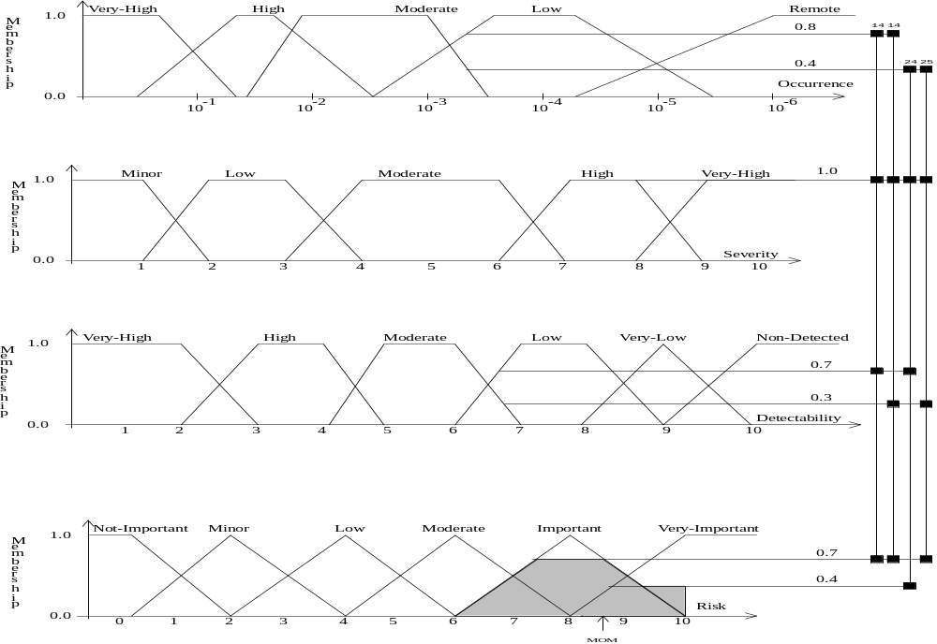
Fuzzy Expert Systems

Slide 19
Fuzzy Expert Systems
n
∑
w
x
i
i
i
=
=
1
Z
n
0
∑
w
i
i
=
1
Where:
n = the number of quantized output levels
X
th
= the support value at which the i
membership function reaches
i
its maximum value (for trapezoidal membership functions it is
taken as the center of maximal range)
W
th
= the degree of truth of the i
membership function
i
Z
= the weighted Mean of Maximum.
o

Slide 20
Fuzzy Expert Systems
Riskiness
Support Value at max.
Truth Value
Important
8
0.7
Very Important
10
0.4
(
0
.
7
)
*
(
8
)
+
(
0
.
4
)
*
(
10
Z
)
=
=
8
.
7
o
(
0
.
7
)
+
(
0
.
4
)

